Slide 1

GROUP - 11 BIKE RENTAL COUNT PREDICTION : STASTICAL TECHNIQUES
INSTRUCTOR : CHING CHI YANG
ABHISHEK BOGA
VISHNU CHOUNDUR
MANASWINI KOMMAREDDY
JOHNPAUL CHIEMELIE ANAMEGE
SAI NARENDRA REDDY LAKKIREDDY
- U00884042
- U00869233
- U00881454
- U00870359
- U00892852

Slide 2
CONTENTS
Introduction
Dataset
Data Preprocessing
Data Visualization
Transformation
Feature Selection
Model building
Linear Regression
Linear Regression with Interaction Terms
Linear Regression with polynomial
Subset Selection – Forward and Backward Selection
Regularization Techniques or Shrinkage Methods – Lasso and Ridge Regression
Dimension Reduction Method – PCR
Random Forest Regression
Boosting Technique – Gradient Boosting Machine
Neural Network
Results
Conclusion
Futurescope

Slide 3
INTRODUCTION
At the heart of our project lies a singular goal: to craft a predictive model that not only reads the patterns of bike usage but also predicts them with precision. To this end, we are rigorously testing a spectrum of machine learning models, engaging in a comparative analysis to determine which algorithm reigns supreme in forecasting bike count based on variables like working days, seasons, and other vital parameters
Beyond the aim of prediction accuracy, our mission is to meticulously evaluate and identify the most effective model from a cadre of contenders.
Through this exploration, we aim to distill the essence of what makes a model not just functional, but exceptional, in predicting bike-sharing demand.

Slide 4
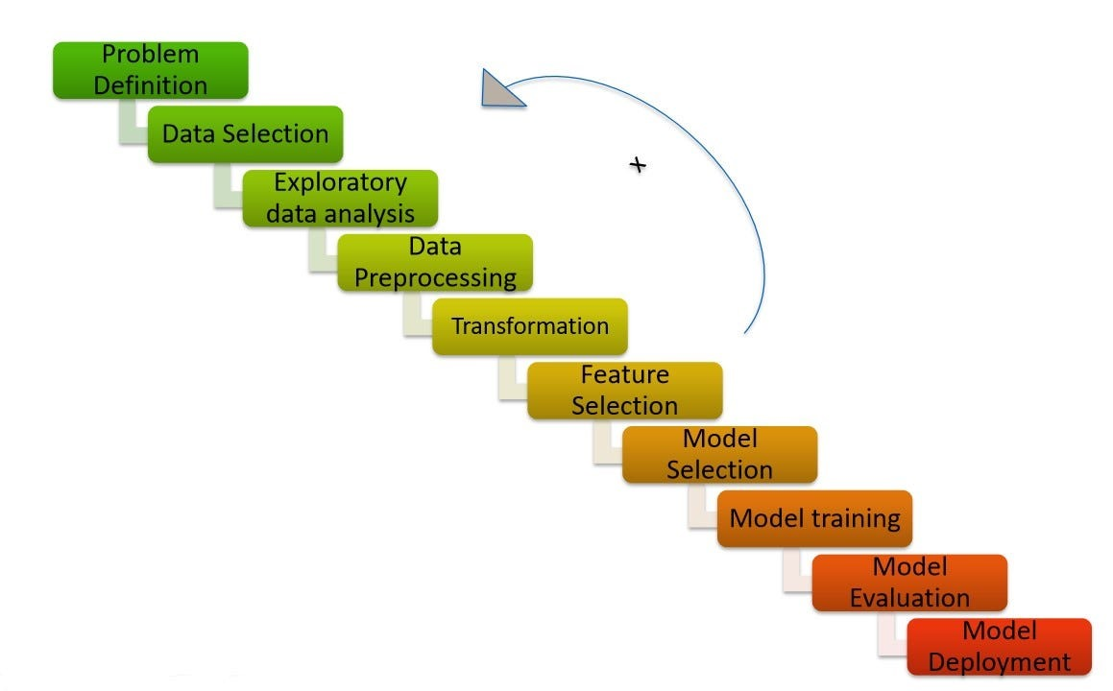
MACHINE LEARNING LIFE CYCLE
Problem Statement : To predict the bike rental count based on hourly based on the environmental and seasonal settings.
Data Selection :
Source : UC Irvine Machine Learning Repository,
Link : https://archive.ics.uci.edu/dataset/275/bike+sharing+dataset
Here, two dataset we have : 1. hour.csv (17379*17) and day.csv (731*16).
We choose hour.csv dataset.
Dimension dataset : 17379 *17
1 – Index, 2 – date, 3-10 – Categorical,
11-14 – Numerical and 15 – 17 – Dependent Variables

Slide 5
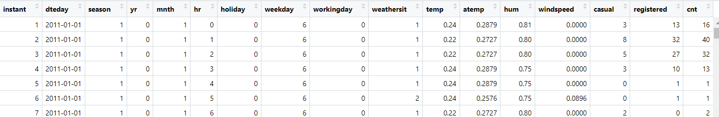
Data Set
instant: record index
dteday : date
season : season (1:springer, 2:summer, 3:fall, 4:winter)
yr : year (0: 2011, 1:2012)
mnth : month ( 1 to 12)
hr : hour (0 to 23)
holiday : weather day is holiday or not
weekday : day of the week
workingday : if day is neither weekend nor holiday is 1, otherwise is 0.
weathersit :
1: Clear, Few clouds, Partly cloudy, Partly cloudy
2: Mist + Cloudy, Mist + Broken clouds, Mist + Few clouds, Mist
3: Light Snow, Light Rain + Thunderstorm + Scattered clouds, Light Rain + Scattered clouds
4: Heavy Rain + Ice Pallets + Thunderstorm + Mist, Snow + Fog
temp : Normalized temperature in Celsius. The values are divided to 41 (max)
atemp: Normalized feeling temperature in Celsius. The values are divided to 50 (max)
hum: Normalized humidity. The values are divided to 100 (max)windspeed: Normalized wind speed. The values are divided to 67 (max)
casual: count of casual users
registered: count of registered users
cnt: count of total rental bikes including both casual and registered

Slide 6
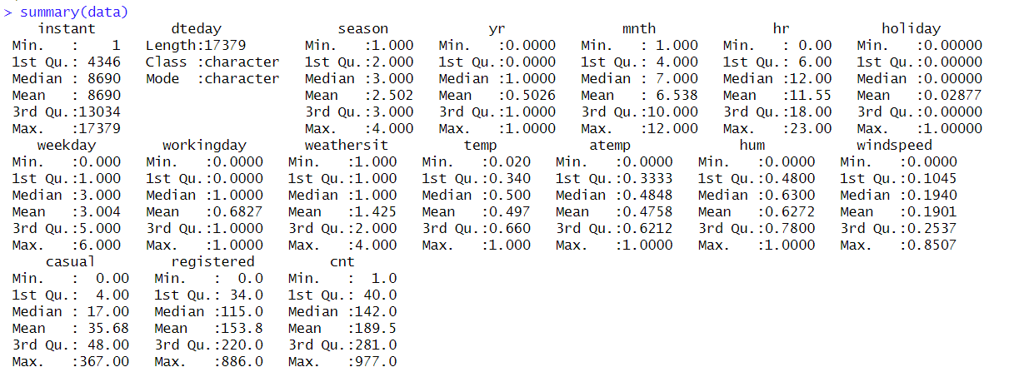
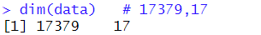
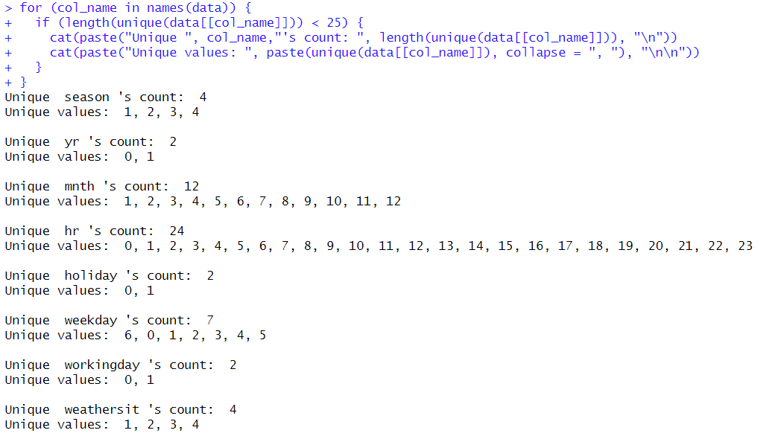
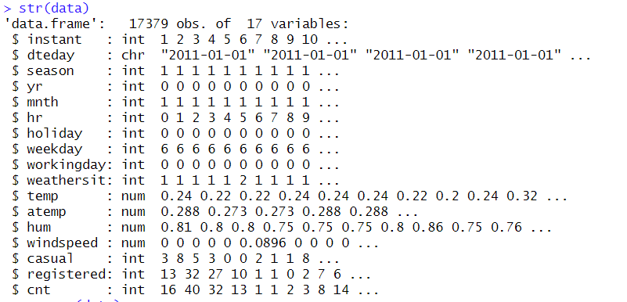
I

Slide 7
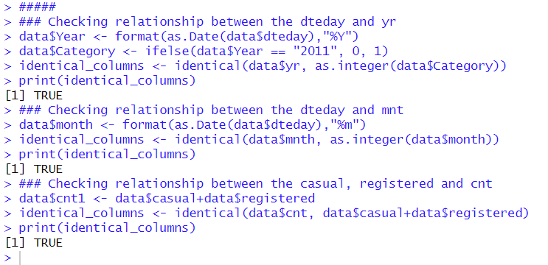
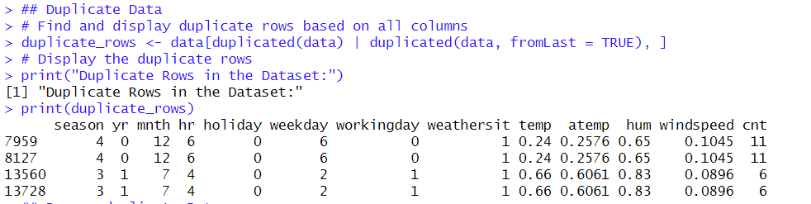
Data Preprocessing
Handling Missing Data
Data Cleaning
Handling Date and Time Data

Slide 8

Data Visualization And Analysis
Histogram
Scatter Plot
Box Plot
Correlation

Slide 9
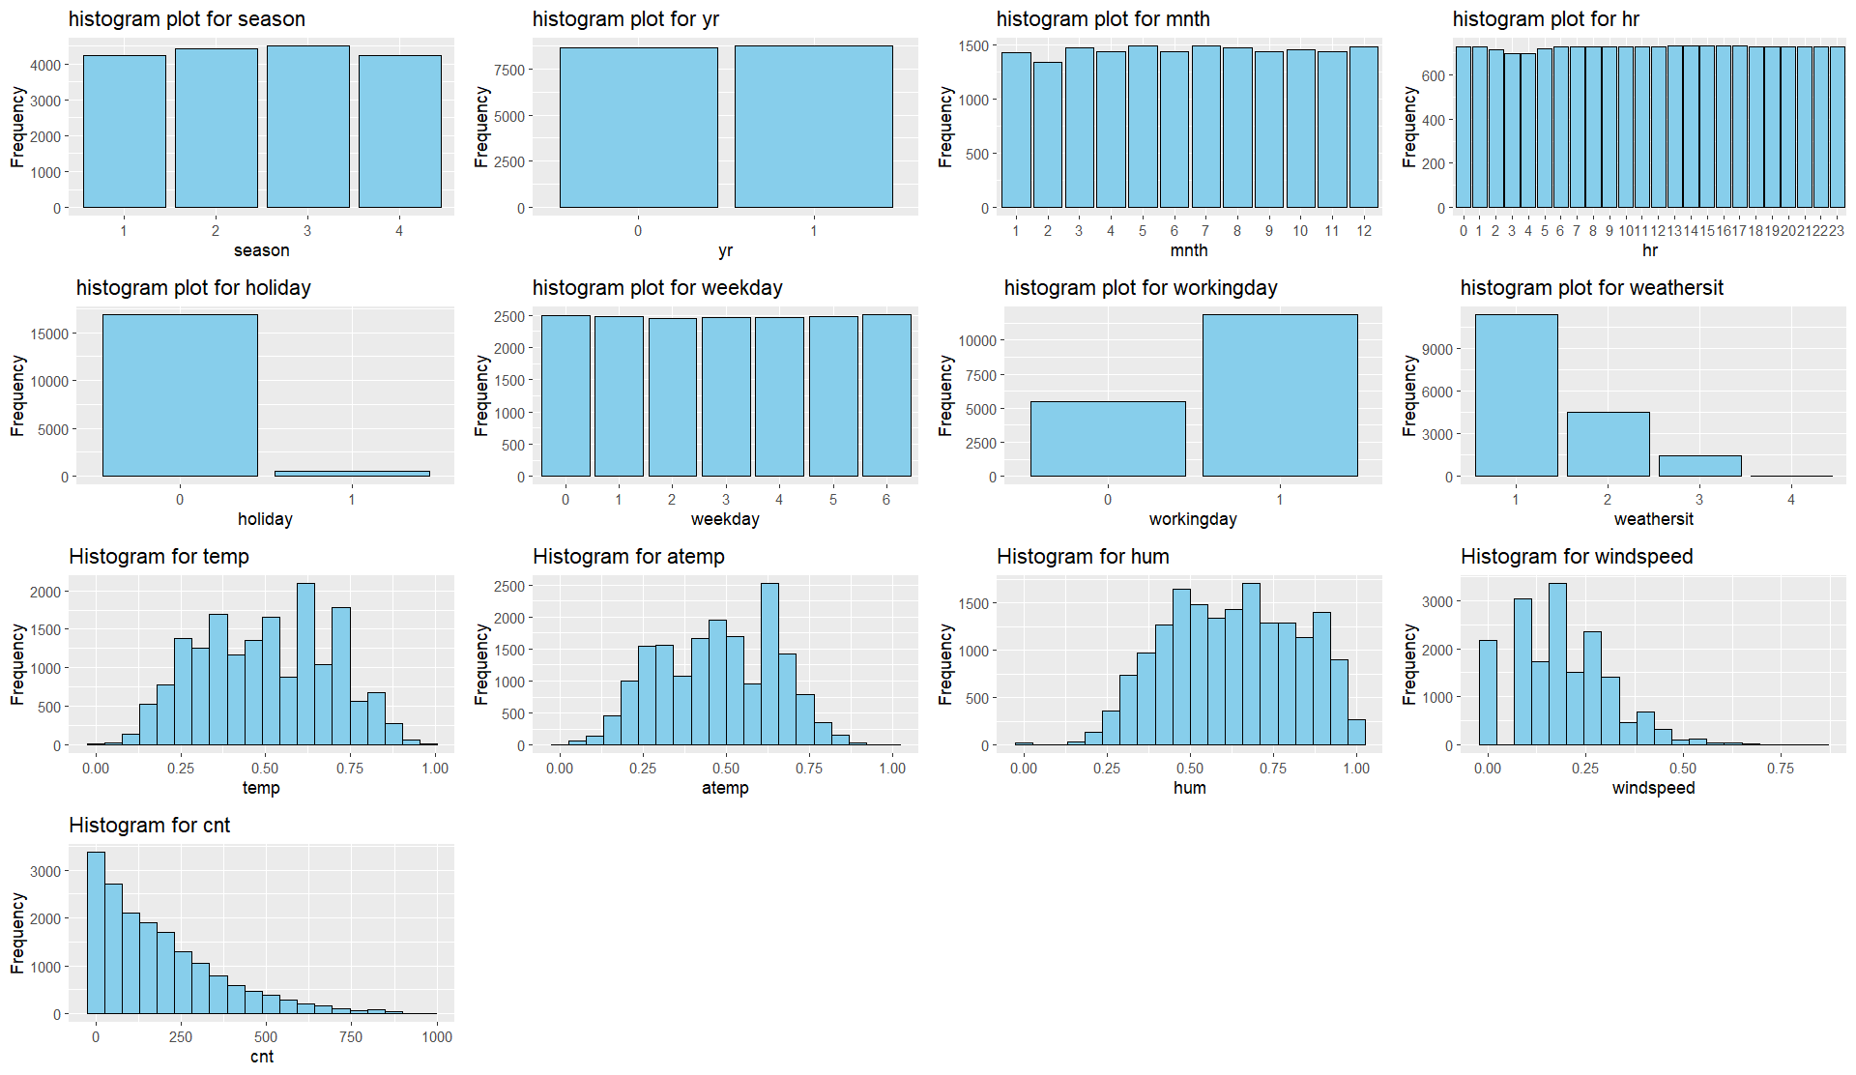
Histogram

Slide 10
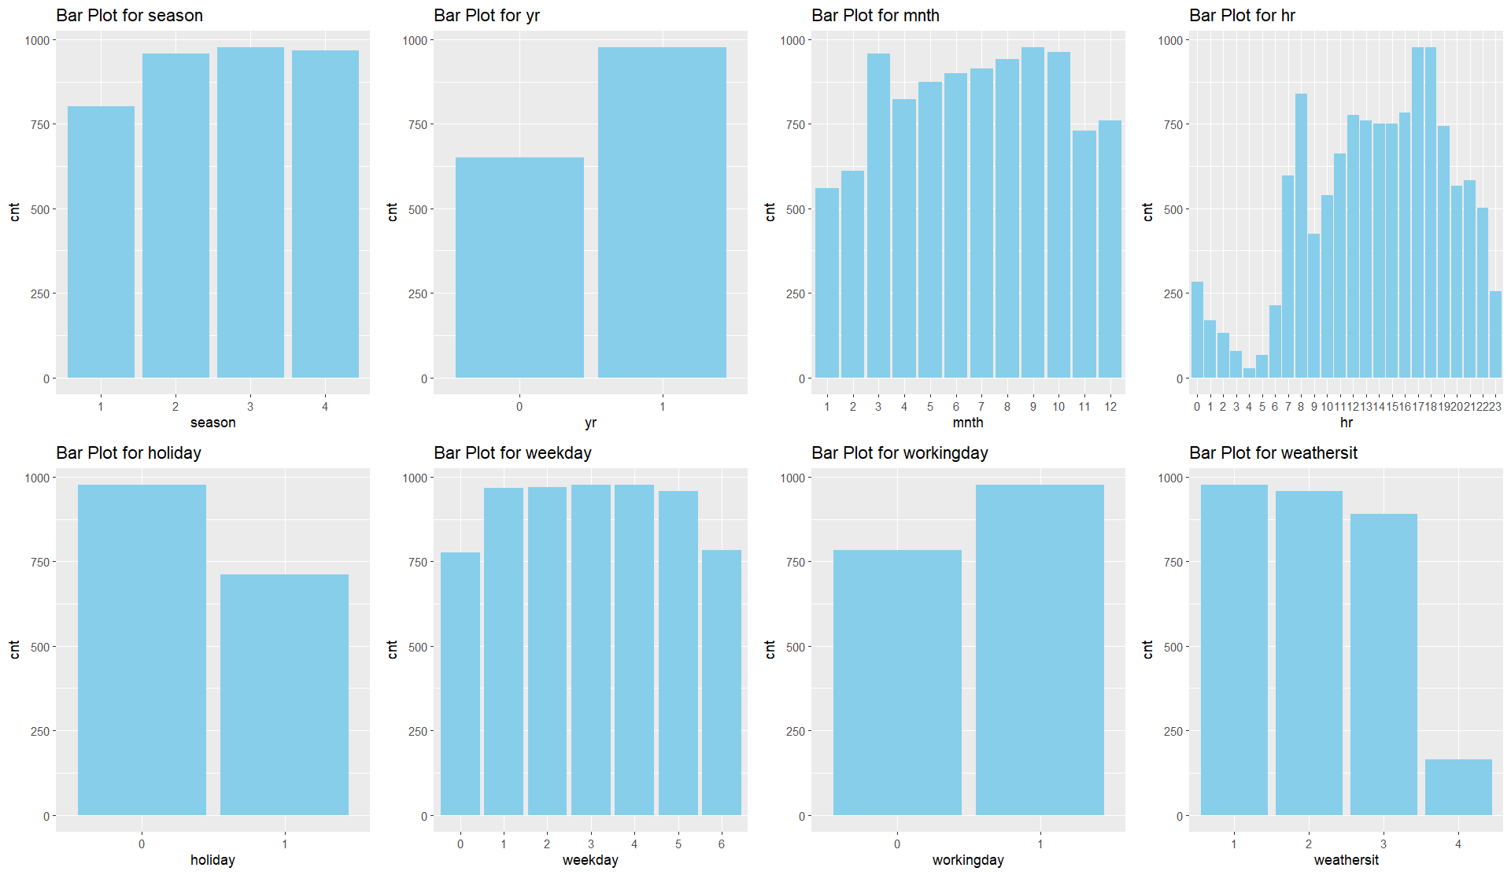
Bar Plot

Slide 11
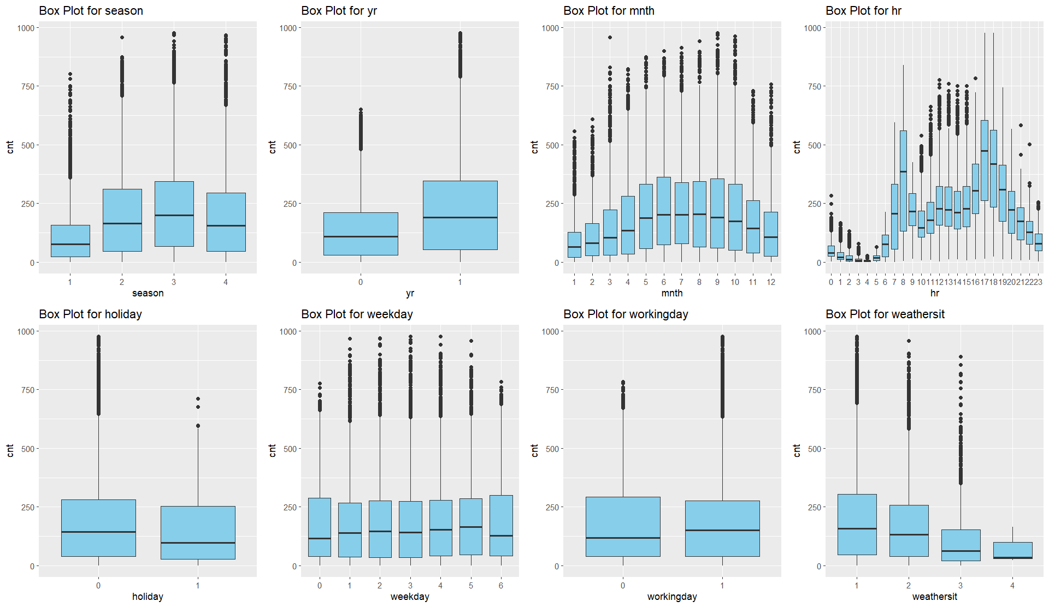
Box Plot

Slide 12
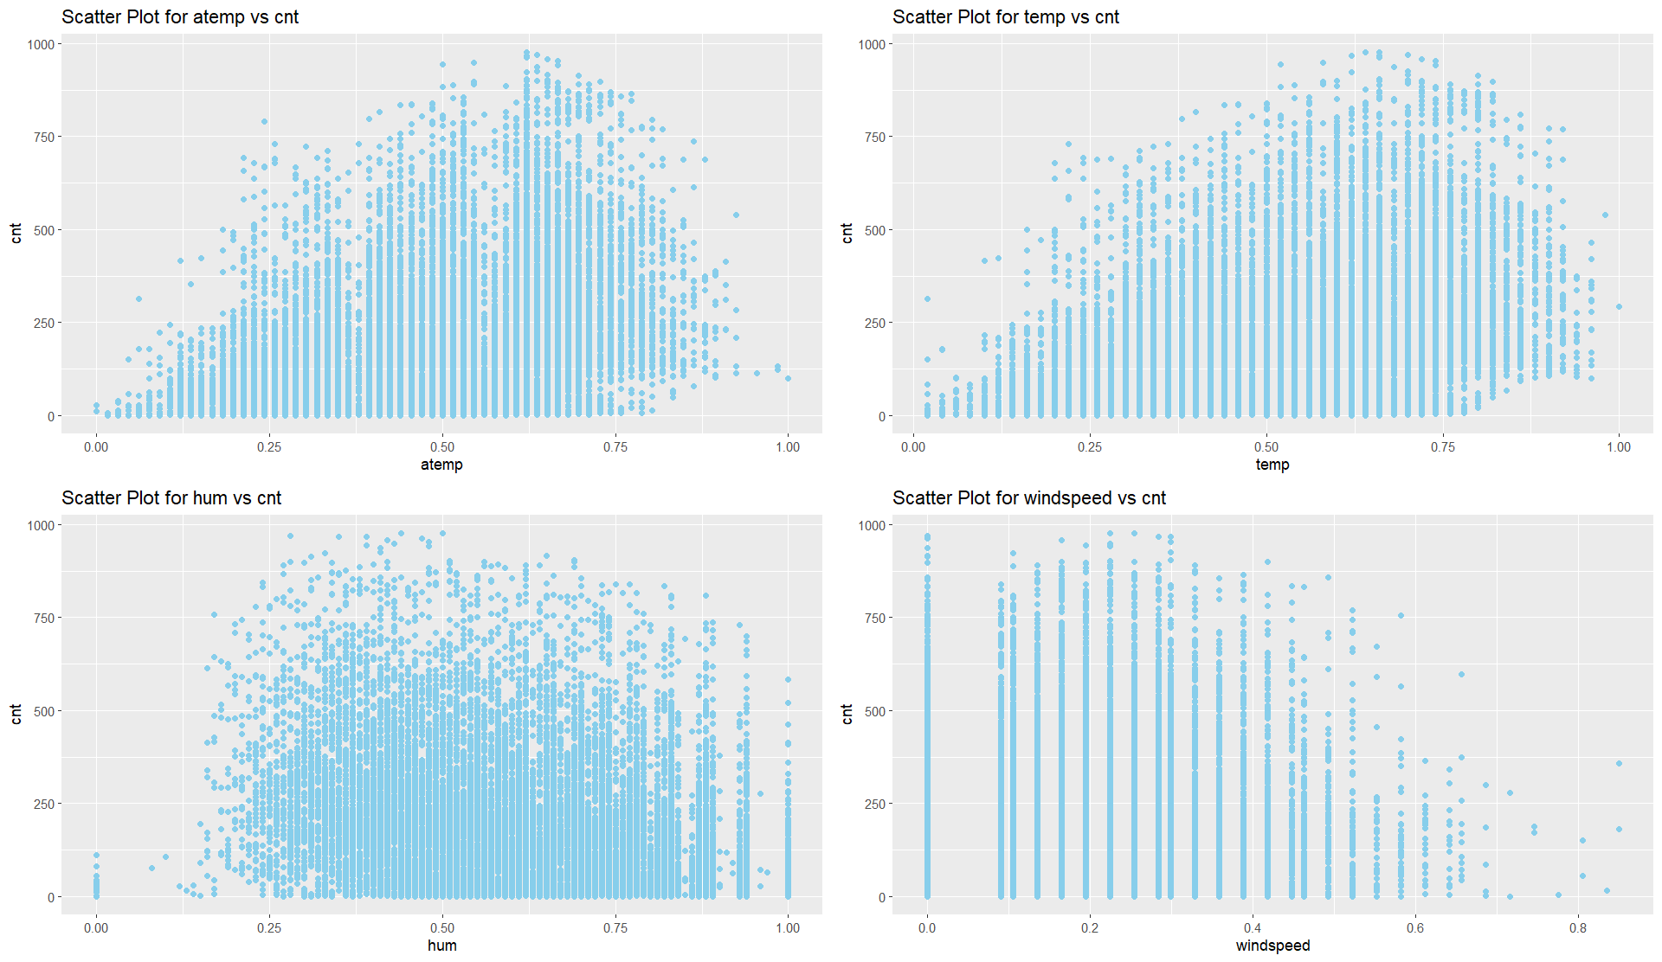
Scatter Plot

Slide 13
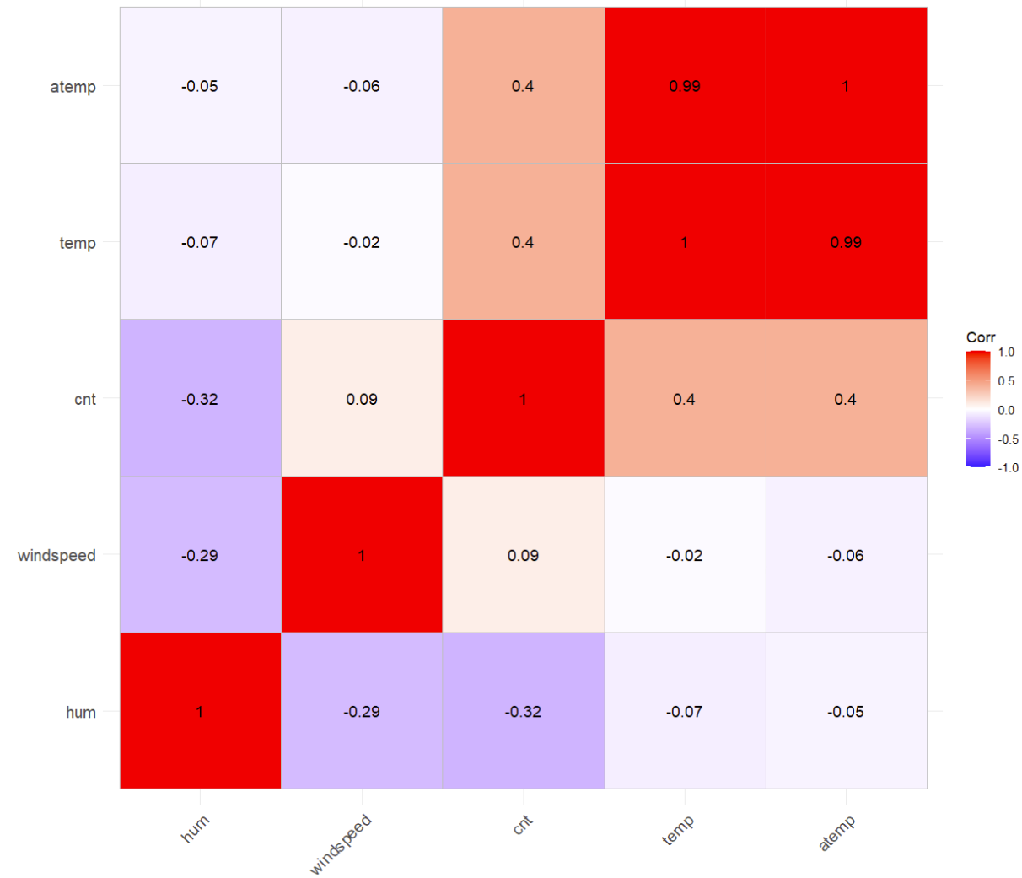
CORRELATION

Slide 14
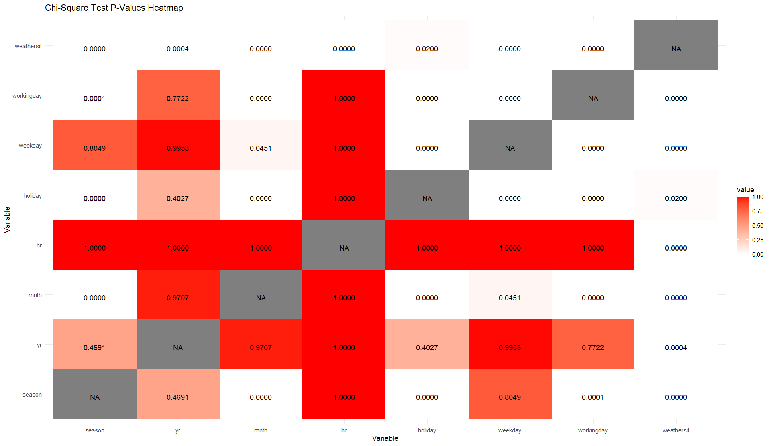
CHI – SQUARE TEST

Slide 15
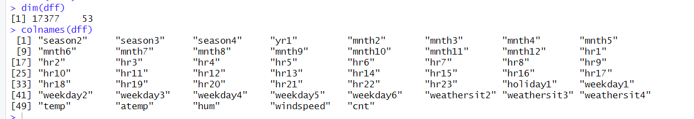
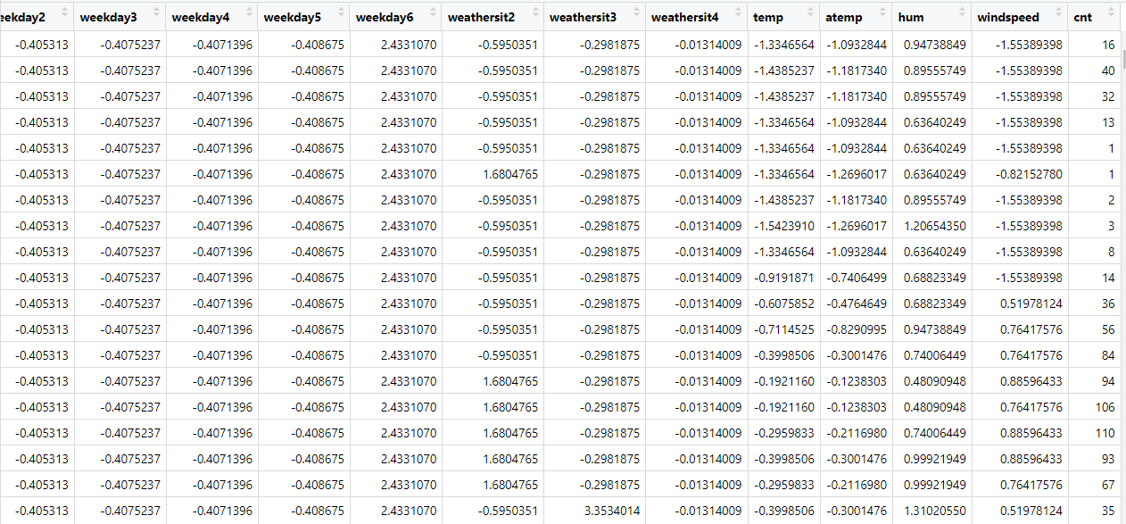
Transformation
Scaling using the Z normalization
Improved convergence for gradient Descent
Scale Invariance for some algorithmns
Interpretability and comparisons
Regularization Stability
Identified and converted the categorical into factors and then converted into numerical using dummies.
Scaled the numerical variable using the z Transformation.

Slide 16
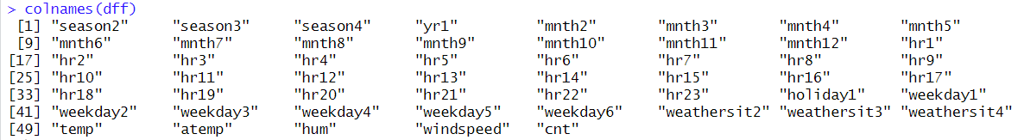
Feature Selection
“dteday” is a combination of “yr” and “mnth”.
“instant” is index number
“workingday” is associated with “holiday” and “weekday”
“cnt” is also associated with “casual” and “registered”
So, removed “dteday”, “instant”, “workingday”, “casual” and “registered.”

Slide 17

MODEL BUILDING AND EVALUATION

Slide 18

SIMPLE LINEAR REGRESSION

Slide 19
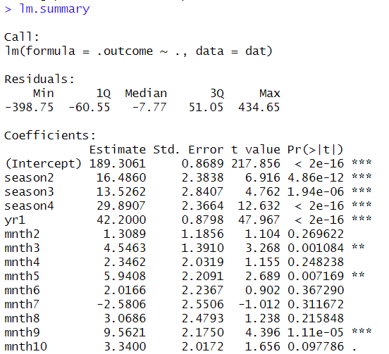
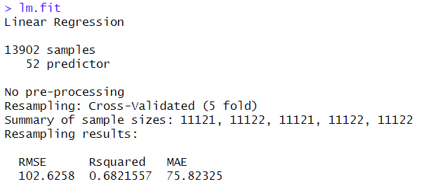
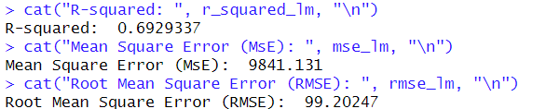
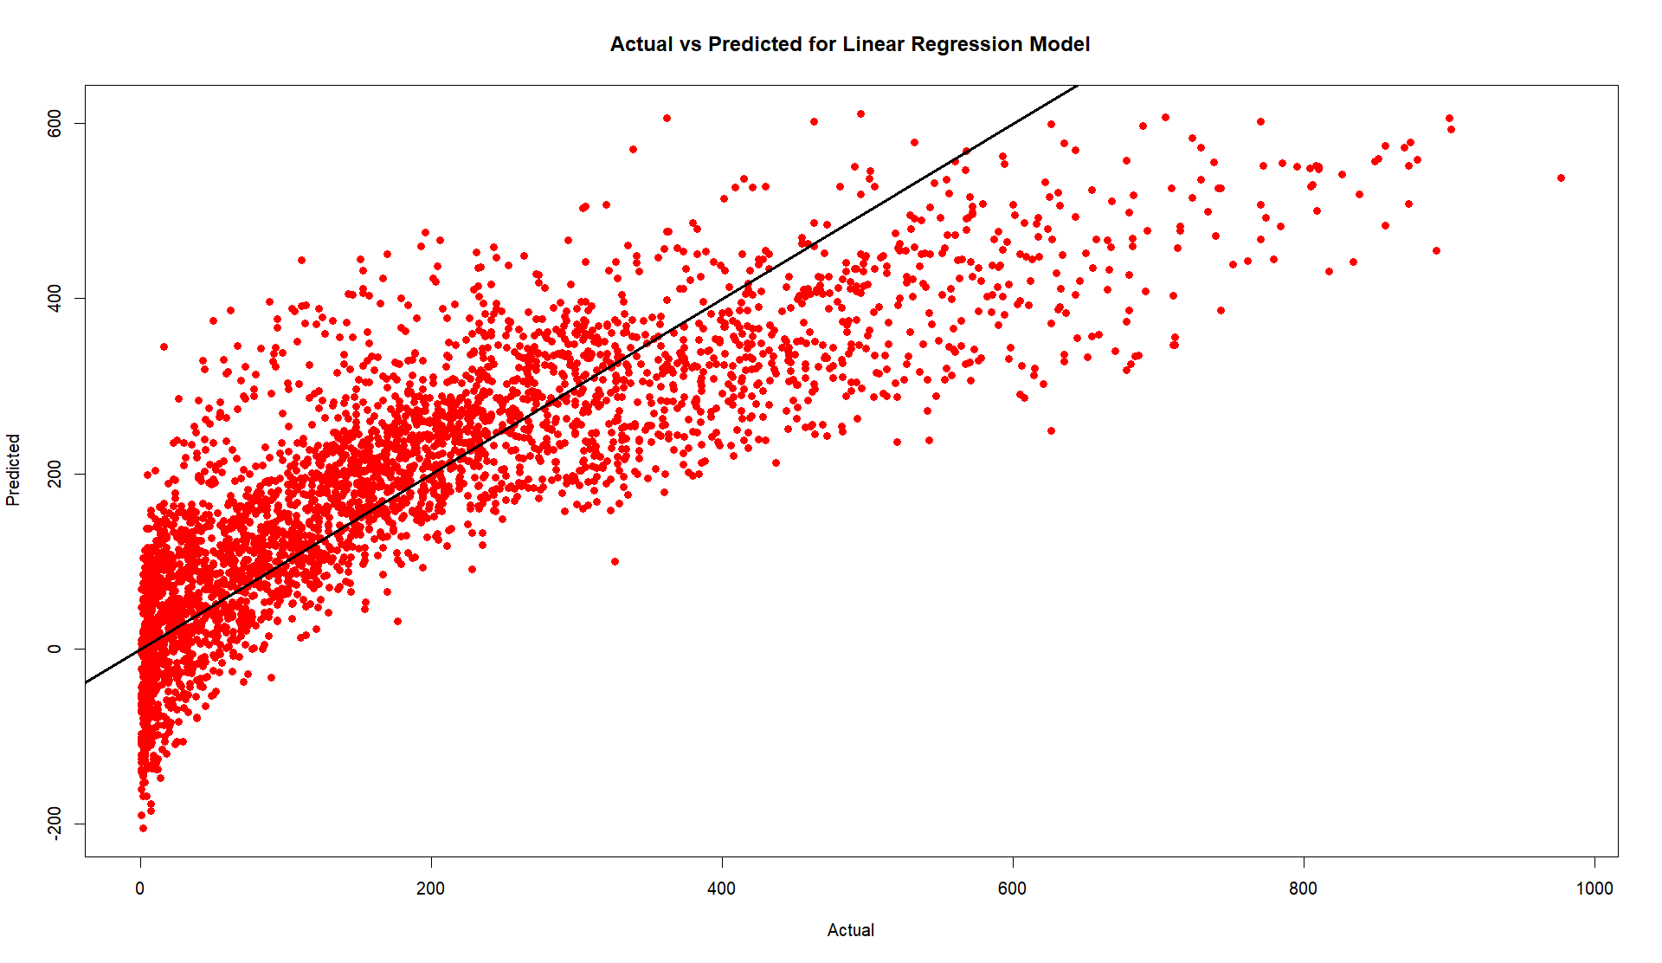
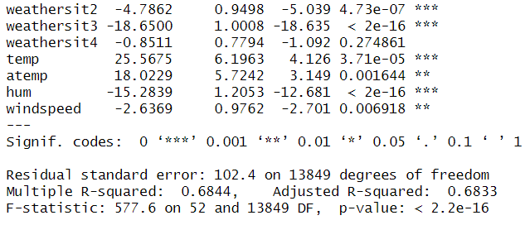
SIMPLE LINEAR REGRESSION

Slide 20

LINEAR REGRESSION WITH INTERACTION TERMS

Slide 21
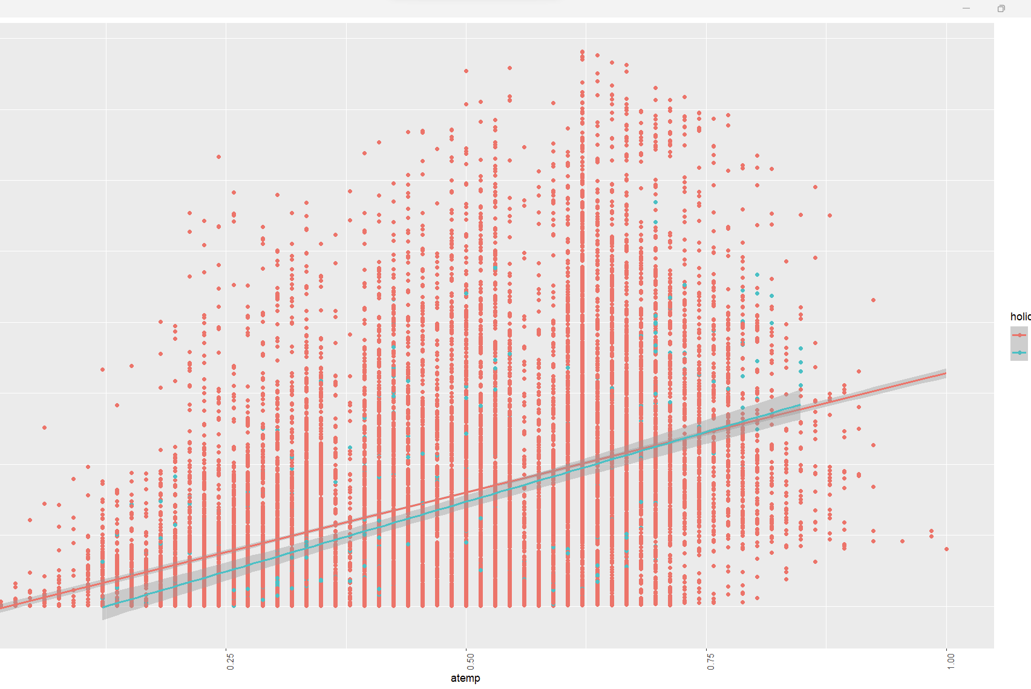
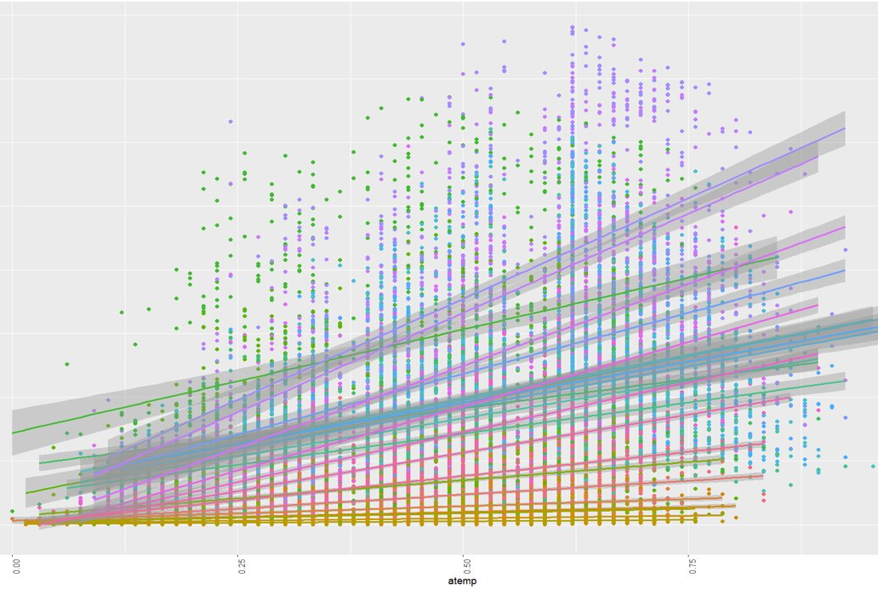
LINEAR REGRESSION WITH INTERACTION TERMS
INTERACTION TERM

Slide 22
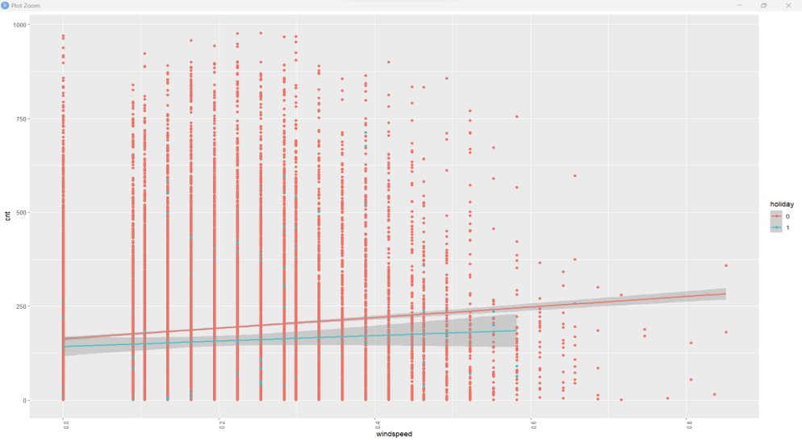
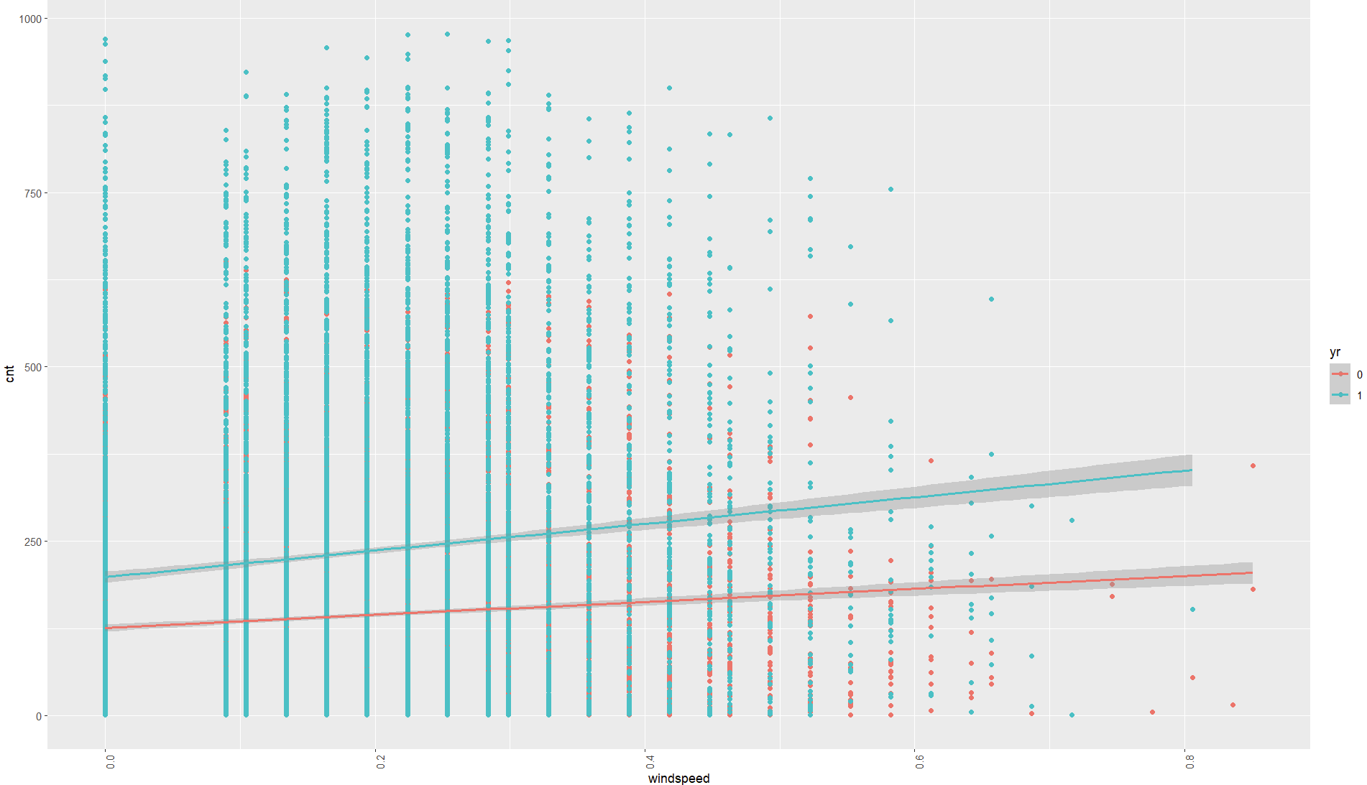
NON - INTERACTION TERM

Slide 23
LINEAR REGRESSION WITH INTERACTION TERMS
- Following Interaction terms causing the Multicollinearity
season*mnth
season*weathersit
mnth*holiday
mnth*weathersit
hr2*weathersit
holiday*weekday
holiday*weathersit
weekday*weathersit
weathersit*temp
weathersit*atemp
weathersit*hum
weathersit*windspeed
- Finally considered the Interaction terms
holiday*atemp
temp*atemp
season*yr
yr*atemp
hr*holiday
season*hr
yr*hr
mnth*hr
yr*hr
mnth*hr
yr*hr
mnth*hum
yr*mnth
hr*weekday

Slide 24
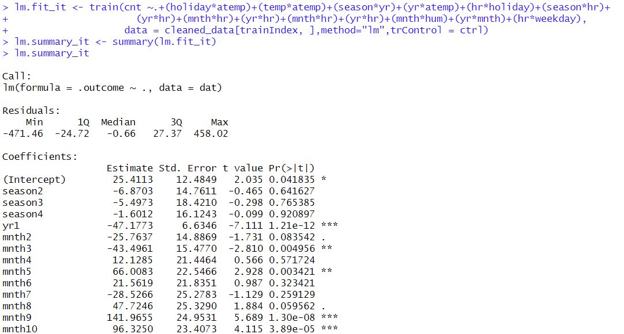
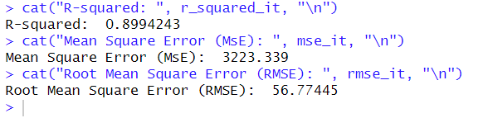
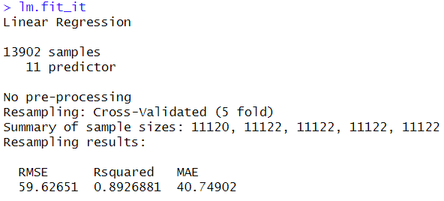
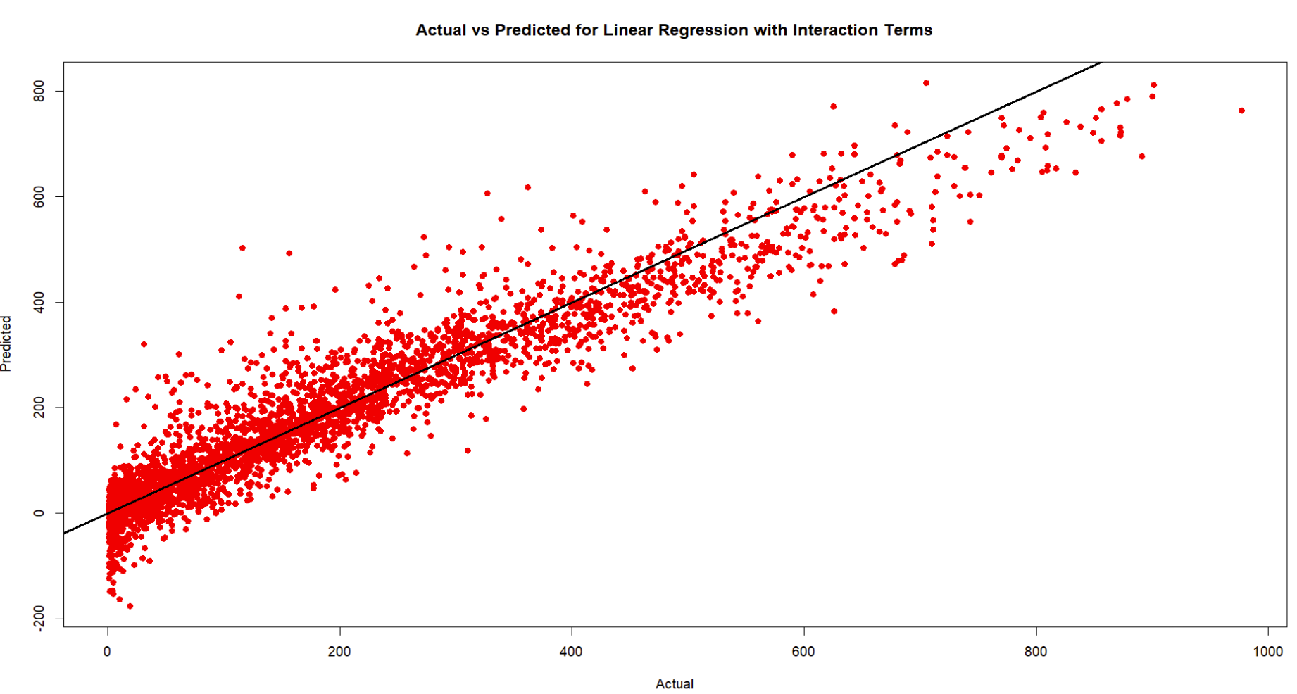
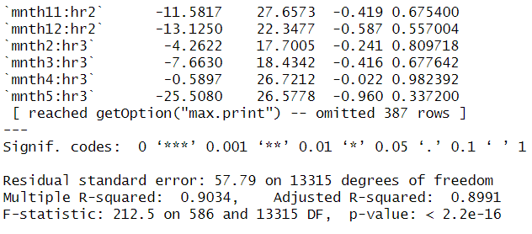
LINEAR REGRESSION WITH INTERACTION TERMS
METRICS WITH TEST DATA
MODEL
I

Slide 25

LINEAR REGRESSION WITH POLYNOMIAL DEGREE

Slide 26
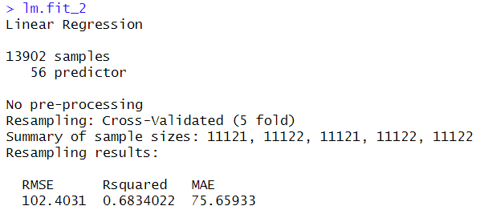
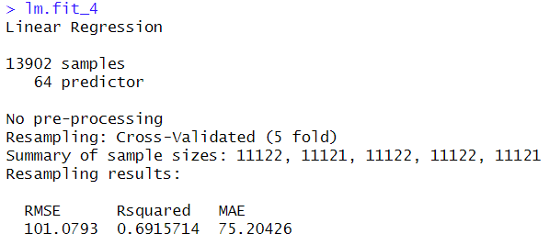
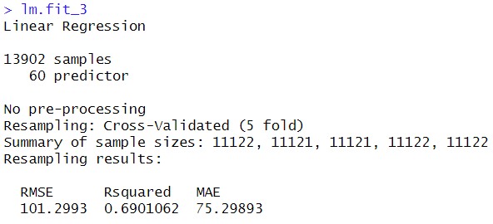
LINEAR REGRESSION WITH POLYNOMIAL DEGREE
Results for degree 2
Results for degree 4
Results for degree 3

Slide 27
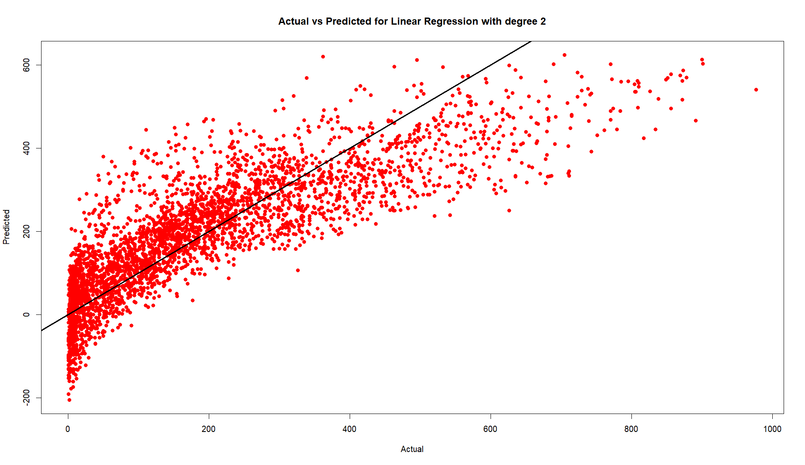
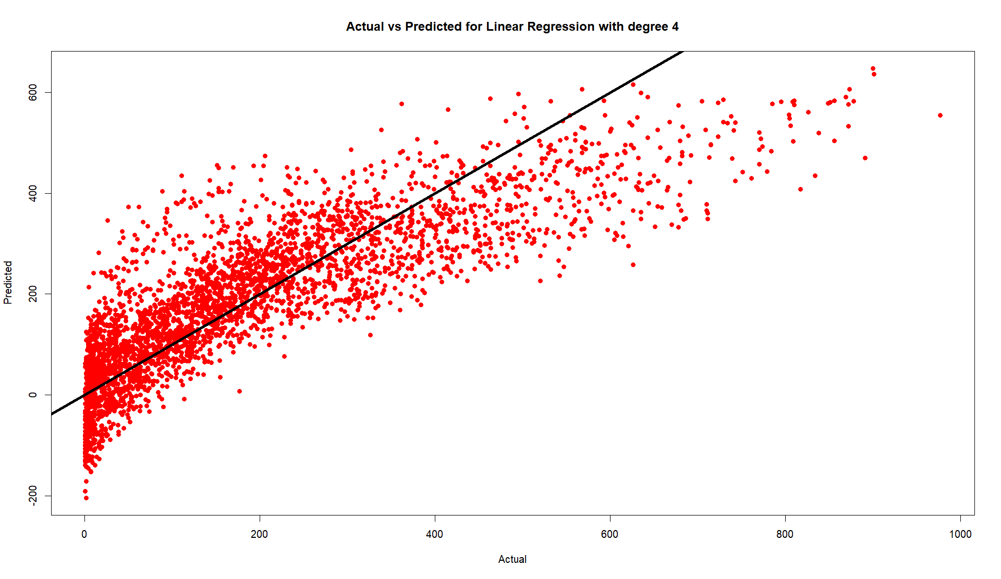

LINEAR REGRESSION WITH POLYNOMIAL DEGREE
Results for degree 2
Results for degree 4
Results for degree 3

Slide 28
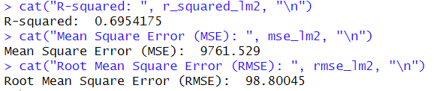
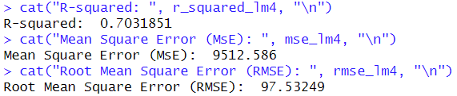
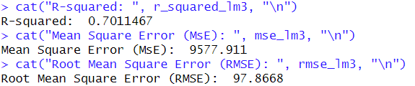
LINEAR REGRESSION WITH POLYNOMIAL DEGREE
Results for degree 2
Results for degree 4
Results for degree 3

Slide 29

SUBSET SELECTION FORWARD AND BACKWARD SELECTION

Slide 30
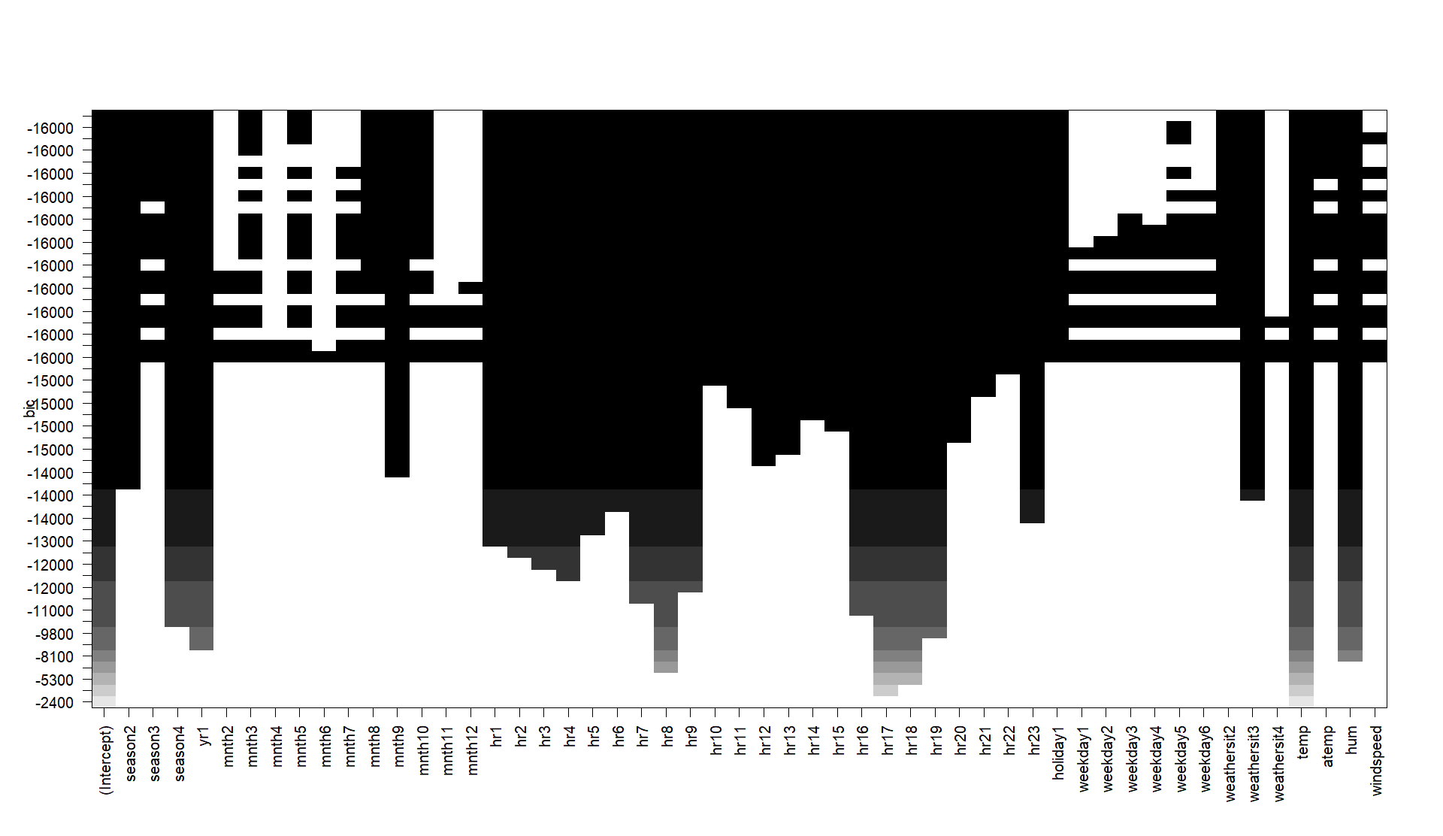
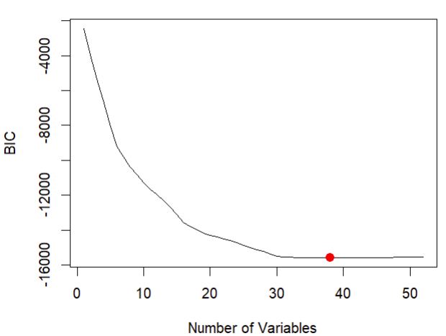
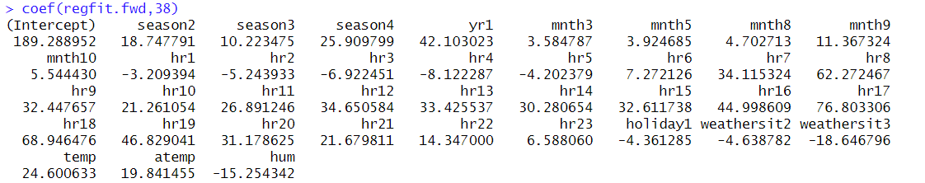
SUBSET SELECTION FORWARD SELECTION
I

Slide 31
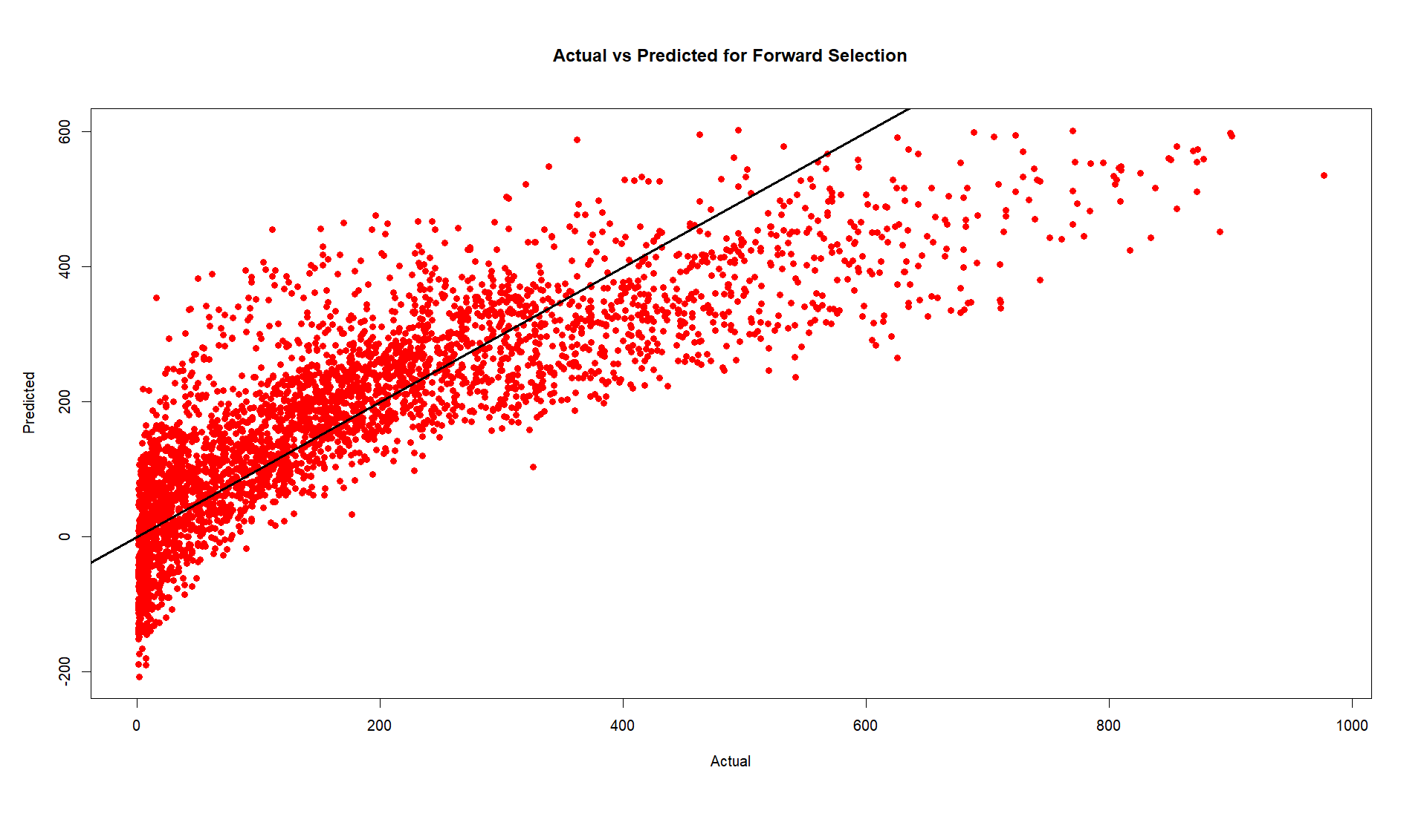
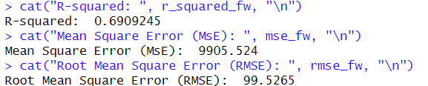
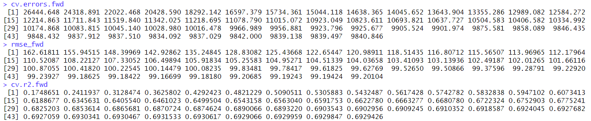
FORWARD SELECTION
I

Slide 32
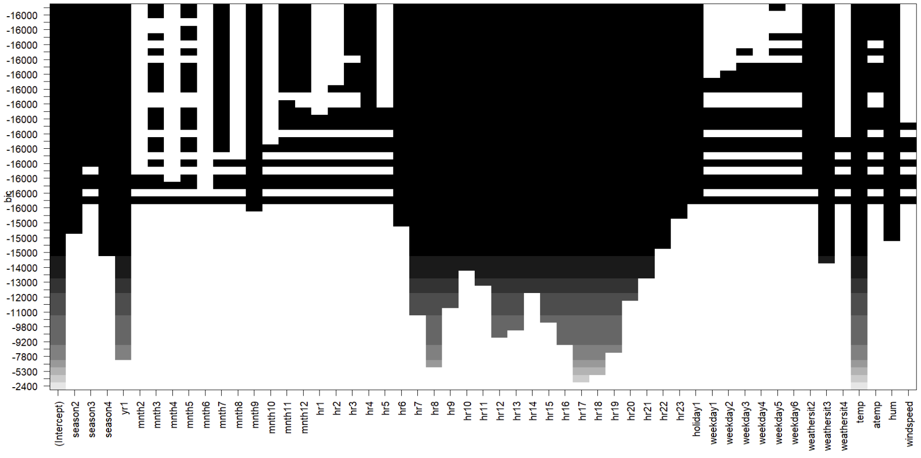
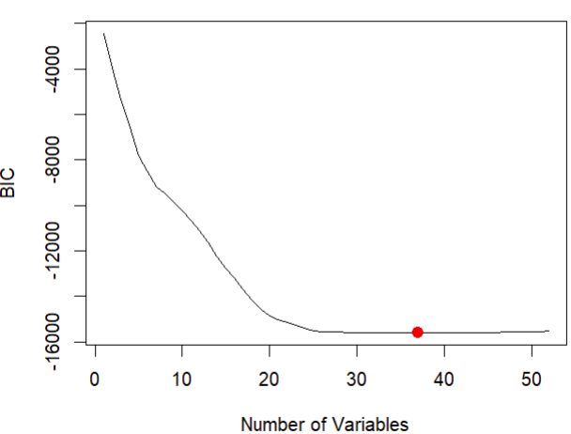
SUBSET SELECTION BACKWARD SELECTION
I

Slide 33
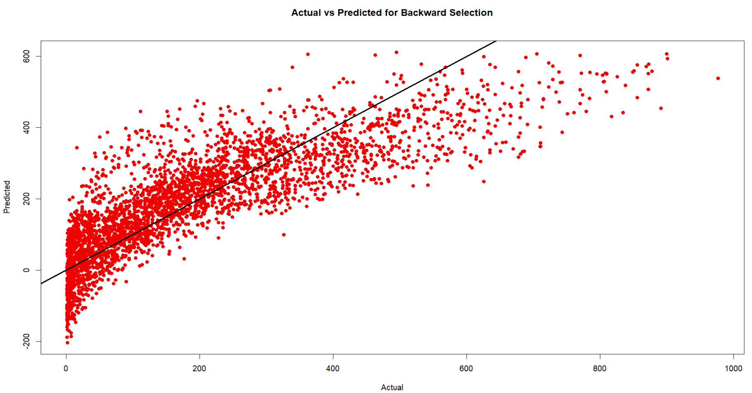
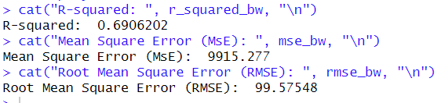
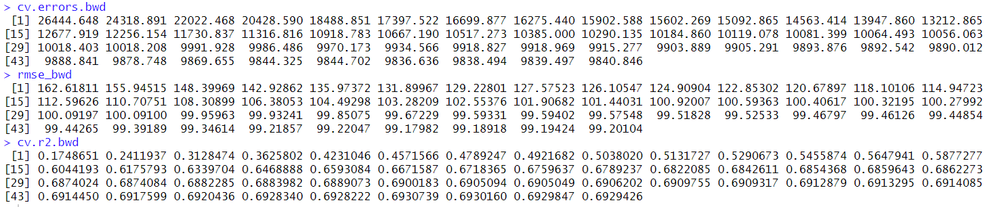
BACKWARD SELECTION
I

Slide 34

REGULARIZATION OR SHRINKAGE TECHNIQUES LASSO AND RIDGE REGRESSION

Slide 35



LASSO REGRESSION
I

Slide 36




LASSO REGRESSION
I
Prediction with test data

Slide 37



RIDGE REGRESSION
I

Slide 38




RIDGE REGRESSION
I
Prediction with test data

Slide 39

DIMENSION REDUCTION METHOD PRINCIPLE COMPONENT REGRESSION

Slide 40




PRINCIPLE COMPONENT REGRESSION
I

Slide 41

RANDOM FOREST

Slide 42




RANDOM FOREST
Trees Vs Error
I

Slide 43

BOOSTING TECHNIQUE GRADIENT BOOSTING MACHINE

Slide 44




GBM
I

Slide 45

NEURAL NETWORK

Slide 46


NEURAL NETWORK
interconnected nodes or neurons to process and learn from data. It excels in pattern recognition and problem-solving in various AI and machine learning applications.
A neural network is a computational model inspired by the brain's biological networks, using interconnected nodes or neurons to process and learn from data. It excels in pattern recognition and problem-solving in various AI and machine learning applications.

Slide 47



NEURAL NETWORK

Slide 48




RESULTS
Mean Square Error (MSE)
Root Mean Square Error (RMSE)
R Square ($R^{2}$)

Slide 49

MODEL EVALUATION
Model | MSE | RMSE | $$R^{2}$$
Linear Regression | 9841.131 | 99.20247 | 69.29337
Linear Regression – Poly 2 | 9761.529 | 98.80045 | 69.54175
Linear Regression – Poly 3 | 9577.911 | 97.8668 | 70.11467
Linear Regression – Poly 4 | 9512.586 | 97.53249 | 70.31851
Linear Regression – Interaction term | 3223.339 | 56.77445 | 89.94243
Forward Sub Selection | 9905.524 | 99.5265 | 69.09245
Backward Sub selection | 9915.277 | 99.57548 | 69.06202
Lasso Regression | 11595.847 | 107.68402 | 63.81824
Ridge Regression | 9980.374 | 99.90182 | 68.8589
Random Forest | 4987.375 | 70.62135 | 84.43822
Gradient Boosting Machine | 2275.473 | 47.70192 | 92.89999
Principle Component Analysis | 9839.166 | 99.19257 | 69.2995
Neural Network | 2362.696 | 48.60757 | 92.62784

Slide 50

CONCLUSION
The Gradient Boosting Machine (GBM) and Neural Network models outperformed others in predicting bike-sharing demand, with the GBM showing the lowest error rates and a high $R^{2}$ value, highlighting its precise predictions.
The elapsed time for Neural Network is good when compared to GBM, RF, Linear Regression with interaction terms.
While traditional models like Linear Regression lagged in performance, introducing interaction terms significantly improved results, underscoring the importance of feature interplay in predictive accuracy.
The Random Forest algorithm also demonstrated solid predictive capabilities, suggesting it as a reliable alternative. Overall, the GBM and Neural Network are the preferred models for their superior prediction quality in bike-sharing demand forecasting.

Slide 51
FUTURE SCOPE
In the future, our project aims to significantly expand its scope and impact. We plan to integrate real-time data to enhance prediction accuracy, and extend the model to encompass a wider range of urban transportation modes, providing a more comprehensive view of city mobility. Delving deeper into advanced machine learning techniques, we'll strive to refine our predictive capabilities, ensuring the model adapts to diverse urban environments globally.
Additionally, by analyzing user behavior more closely, we aim to tailor the bike-sharing experience, increasing its efficiency and appeal. These steps are not just about advancing the project, but also about contributing to larger goals like reducing urban congestion and promoting sustainable transportation in cities around the world.

